Slide 1
Statistics Refresher
CS771: Introduction to Machine Learning
Purushottam Kar

Slide 2
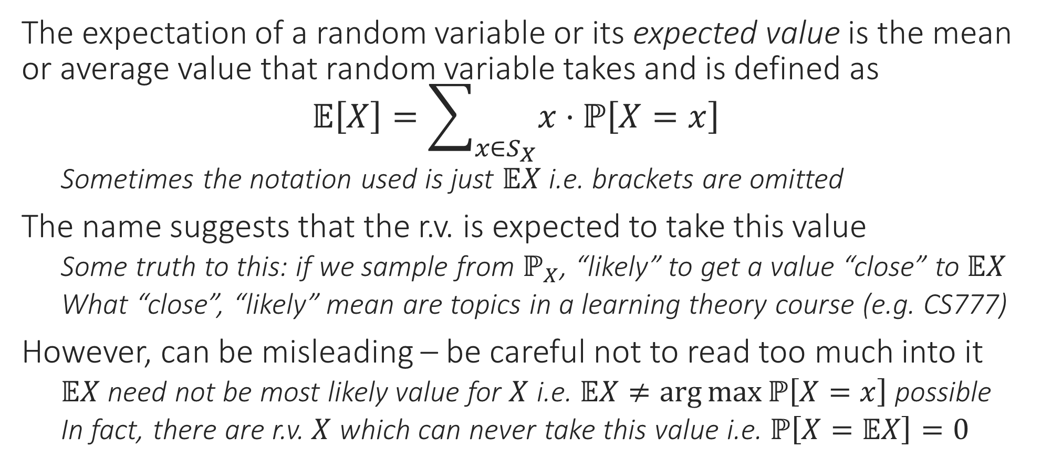
Expectation of a Random Variable
The expectation of a random variable or its expected value is the mean or average value that random variable takes and is defined as $𝔼\left[X\right]=\sum_{x∈S_{X}}{x⋅ℙ\left[X=x\right]}$
Sometimes the notation used is just $𝔼X$ i.e. brackets are omitted
The name suggests that the r.v. is expected to take this value
Some truth to this: if we sample from $ℙ_{X}$, “likely” to get a value “close” to $𝔼X$
What “close”, “likely” mean are topics in a learning theory course (e.g. CS777)
However, can be misleading – be careful not to read too much into it
$𝔼X$ need not be most likely value for $X$ i.e. $𝔼X≠\arg{\max{ℙ\left[X=x\right]}}$ possible
In fact, there are r.v. $X$ which can never take this value i.e. $ℙ\left[X=𝔼X\right]=0$

Slide 3
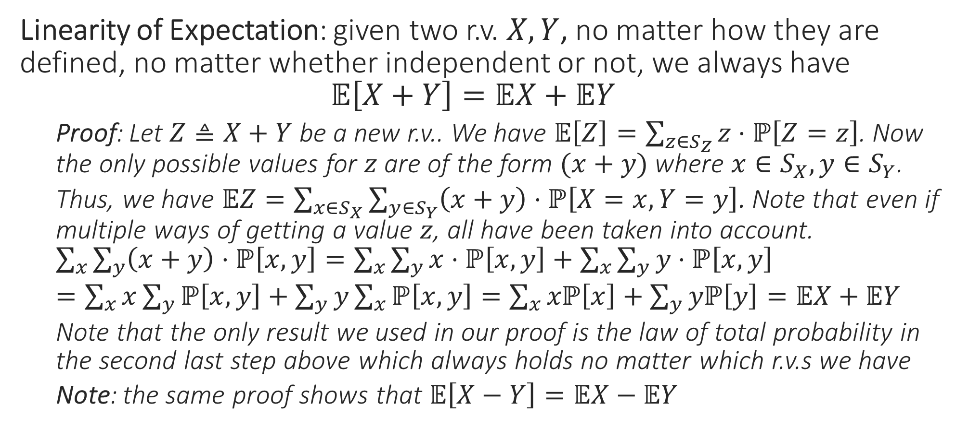
Rules of Expectation: Sum Rule
Linearity of Expectation: given two r.v. $X,Y$, no matter how they are defined, no matter whether independent or not, we always have $𝔼\left[X+Y\right]=𝔼X+𝔼Y$
Proof: Let $Z≜X+Y$ be a new r.v.. We have $𝔼\left[Z\right]=\sum_{z∈S_{Z}}{z⋅ℙ\left[Z=z\right]}$. Now the only possible values for $z$ are of the form $(x+y)$ where $x∈S_{X},y∈S_{Y}$.
Thus, we have $𝔼Z=\sum_{x∈S_{X}}{\sum_{y∈S_{Y}}{\left(x+y\right)⋅ℙ\left[X=x,Y=y\right]}}$. Note that even if multiple ways of getting a value $z$, all have been taken into account. $\sum_{x}{\sum_{y}{\left(x+y\right)⋅ℙ\left[x,y\right]}}=\sum_{x}{\sum_{y}{x⋅ℙ\left[x,y\right]}}+\sum_{x}{\sum_{y}{y⋅ℙ\left[x,y\right]}}$
$=\sum_{x}{x\sum_{y}{ℙ\left[x,y\right]}}+\sum_{y}{y\sum_{x}{ℙ\left[x,y\right]}}=\sum_{x}{xℙ\left[x\right]}+\sum_{y}{yℙ\left[y\right]}=𝔼X+𝔼Y$
Note that the only result we used in our proof is the law of total probability in the second last step above which always holds no matter which r.v.s we have
Note: the same proof shows that $𝔼\left[X−Y\right]=𝔼X−𝔼Y$

Slide 4

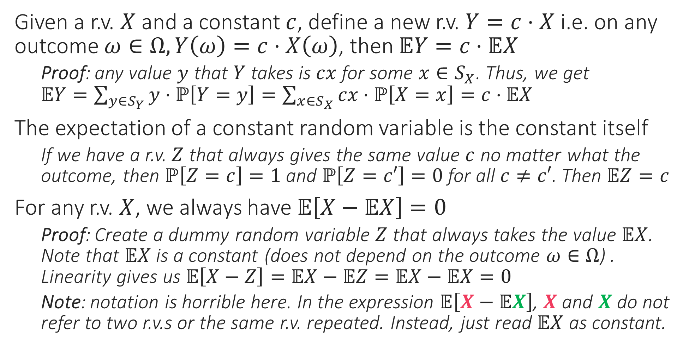
Rules of Expectation: Scaling Rule
Given a r.v. $X$ and a constant $c$, define a new r.v. $Y=c⋅X$ i.e. on any outcome $ω∈Ω,Y\left(ω\right)=c⋅X\left(ω\right)$, then $𝔼Y=c⋅𝔼X$
Proof: any value $y$ that $Y$ takes is $cx$ for some $x∈S_{X}$. Thus, we get $𝔼Y=\sum_{y∈S_{Y}}{y⋅ℙ\left[Y=y\right]}=\sum_{x∈S_{X}}{cx⋅ℙ\left[X=x\right]}=c⋅𝔼X$
The expectation of a constant random variable is the constant itself
If we have a r.v. $Z$ that always gives the same value $c$ no matter what the outcome, then $ℙ\left[Z=c\right]=1$ and $ℙ\left[Z=c′\right]=0$ for all $c≠c′$. Then $𝔼Z=c$
For any r.v. $X$, we always have $𝔼\left[X−𝔼X\right]=0$
Proof: Create a dummy random variable $Z$ that always takes the value $𝔼X$. Note that $𝔼X$ is a constant (does not depend on the outcome $ω∈Ω$) . Linearity gives us $𝔼\left[X−Z\right]=𝔼X−𝔼Z=𝔼X−𝔼X=0$
Note: notation is horrible here. In the expression $𝔼\left[X−𝔼X\right]$, $X$ and $X$ do not refer to two r.v.s or the same r.v. repeated. Instead, just read $𝔼X$ as constant.
For example, if we have a fair coin and create a r.v. $X$ s.t. $X=1$ for heads and $X=0$ for tails, then $𝔼X=0.5$ (since coin is fair) and clearly $𝔼X$ is a constant that does not depend on the outcome of any toss

Slide 5
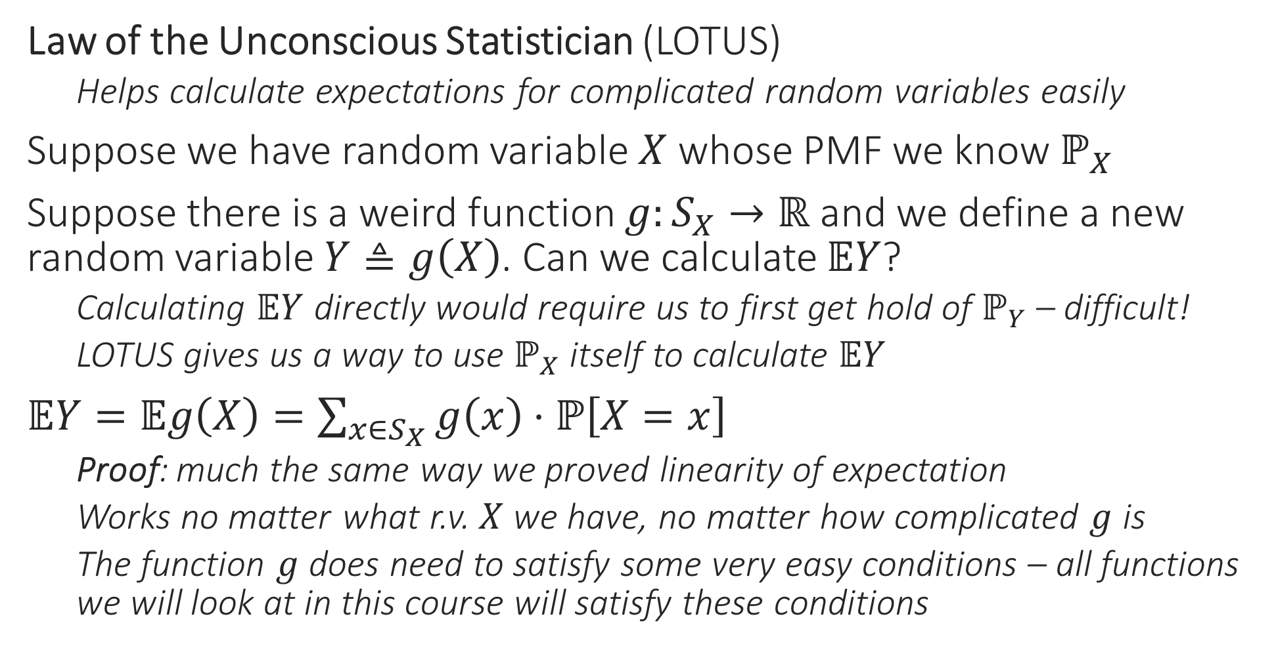
Rules of Expectation
Law of the Unconscious Statistician (LOTUS)
Helps calculate expectations for complicated random variables easily
Suppose we have random variable $X$ whose PMF we know $ℙ_{X}$
Suppose there is a weird function $g:S_{X}→ℝ$ and we define a new random variable $Y≜g\left(X\right)$. Can we calculate $𝔼Y$?
Calculating $𝔼Y$ directly would require us to first get hold of $ℙ_{Y}$ – difficult!
LOTUS gives us a way to use $ℙ_{X}$ itself to calculate $𝔼Y$
$𝔼Y=𝔼g\left(X\right)=\sum_{x∈S_{X}}{g\left(x\right)⋅ℙ\left[X=x\right]}$
Proof: much the same way we proved linearity of expectation
Works no matter what r.v. $X$ we have, no matter how complicated $g$ is
The function $g$ does need to satisfy some very easy conditions – all functions we will look at in this course will satisfy these conditions

Slide 6
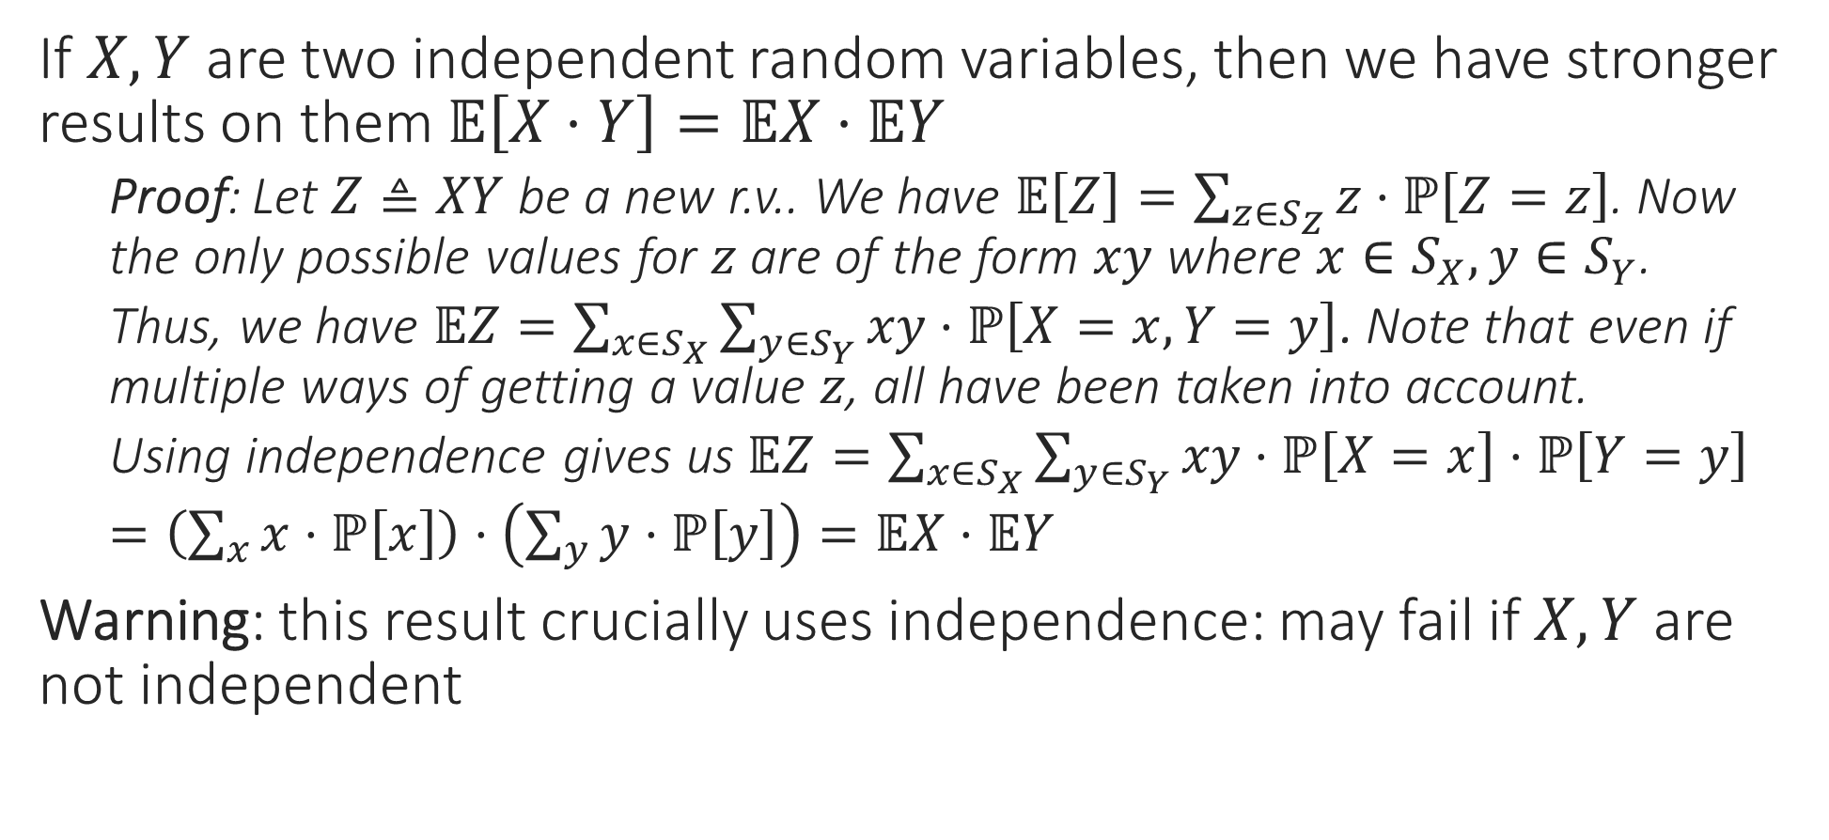
Rules of Expectation: Product Rule
If $X,Y$ are two independent random variables, then we have stronger results on them $𝔼\left[X⋅Y\right]=𝔼X⋅𝔼Y$
Proof: Let $Z≜XY$ be a new r.v.. We have $𝔼\left[Z\right]=\sum_{z∈S_{Z}}{z⋅ℙ\left[Z=z\right]}$. Now the only possible values for $z$ are of the form $xy$ where $x∈S_{X},y∈S_{Y}$.
Thus, we have $𝔼Z=\sum_{x∈S_{X}}{\sum_{y∈S_{Y}}{xy⋅ℙ\left[X=x,Y=y\right]}}$. Note that even if multiple ways of getting a value $z$, all have been taken into account.
Using independence gives us $𝔼Z=\sum_{x∈S_{X}}{\sum_{y∈S_{Y}}{xy⋅ℙ\left[X=x\right]⋅ℙ\left[Y=y\right]}}$
$=\left(\sum_{x}{x⋅ℙ\left[x\right]}\right)⋅\left(\sum_{y}{y⋅ℙ\left[y\right]}\right)=𝔼X⋅𝔼Y$
Warning: this result crucially uses independence: may fail if $X,Y$ are not independent

Slide 7




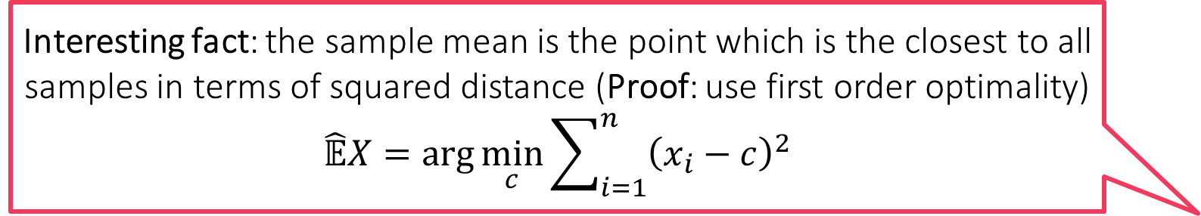
Sample Mean
Indeed! If we ask 1000 random Indians, how many children they have, the sample mean might come out to be 2.35. However, no Indian can have 2.35 children since number of children has to be an integer!
Suppose we have a r.v. $X$ and we sample it again and again, say $n$ times
E.g. we have a dice/coin and we throw/toss it again and again
Make sure that samples are independent of each other
For example in the coin case, do toss the coin fairly $n$ times – do not just toss it once and then blindly repeat the value of the first toss $n$times
Using the values obtained in these repeated samples, say $x_{1},x_{2},…,x_{n}$, we can get a very good estimate $𝔼X$ if $n$ is sufficiently large
Called sample mean, or sample expectation, or empirical mean
$\hat{𝔼}X=\overline{X}=\frac{1}{n}\sum_{i=1}^{n}{x_{i}}$
Note: sample mean can give answers that need careful analysis
Yes, that is why we warned not to take expectation/sample mean literally. All that your experiment tells you is that most Indians have around 2.35 children. Some may have much more (e.g. 7) or much less (e.g. 0) but they are usually rarer
Interesting fact: the sample mean is the point which is the closest to all samples in terms of squared distance (Proof: use first order optimality) $$\hat{𝔼}X=\arg{\min_{c}{\sum_{i=1}^{n}{{\left(x_{i}−c\right)}^{2}}}}$$
Interesting fact: even the mean itself satisfies the nice property $$𝔼X=\arg{\min_{c}{𝔼\left[{\left(X−c\right)}^{2}\right]}}$$

Slide 8
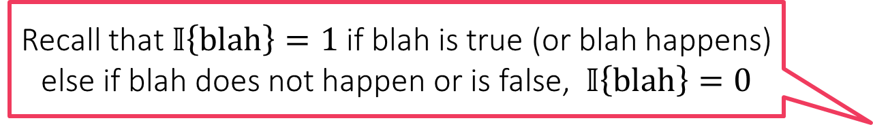
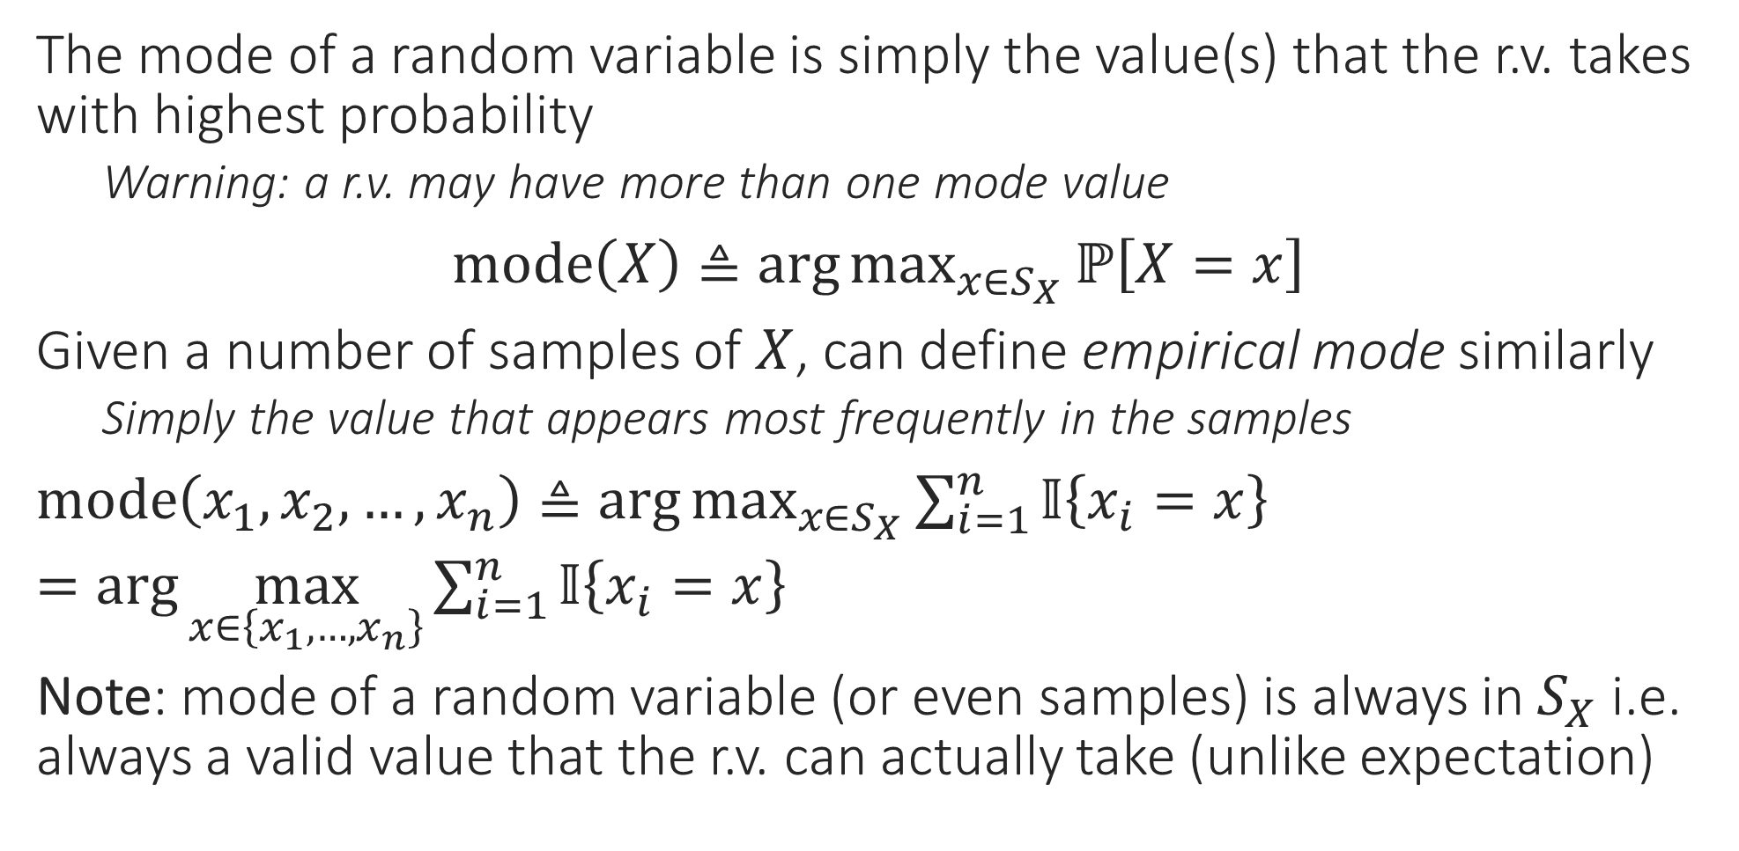
Mode of a Random Variable
The mode of a random variable is simply the value(s) that the r.v. takes with highest probability
Warning: a r.v. may have more than one mode value
$mode\left(X\right)≜\arg{\max_{x∈S_{X}}{ℙ\left[X=x\right]}}$
Given a number of samples of $X$, can define empirical mode similarly
Simply the value that appears most frequently in the samples
$mode\left(x_{1},x_{2},…,x_{n}\right)≜\arg{\max_{x∈S_{X}}{\sum_{i=1}^{n}{𝕀\left\{x_{i}=x\right\}}}}$
$=\arg{\max_{x∈\left\{x_{1},…,x_{n}\right\}}{\sum_{i=1}^{n}{𝕀\left\{x_{i}=x\right\}}}}$
Note: mode of a random variable (or even samples) is always in $S_{X}$ i.e. always a valid value that the r.v. can actually take (unlike expectation)
Recall that $𝕀\left\{blah\right\}=1$ if blah is true (or blah happens) else if blah does not happen or is false, $𝕀\left\{blah\right\}=0$

Slide 9

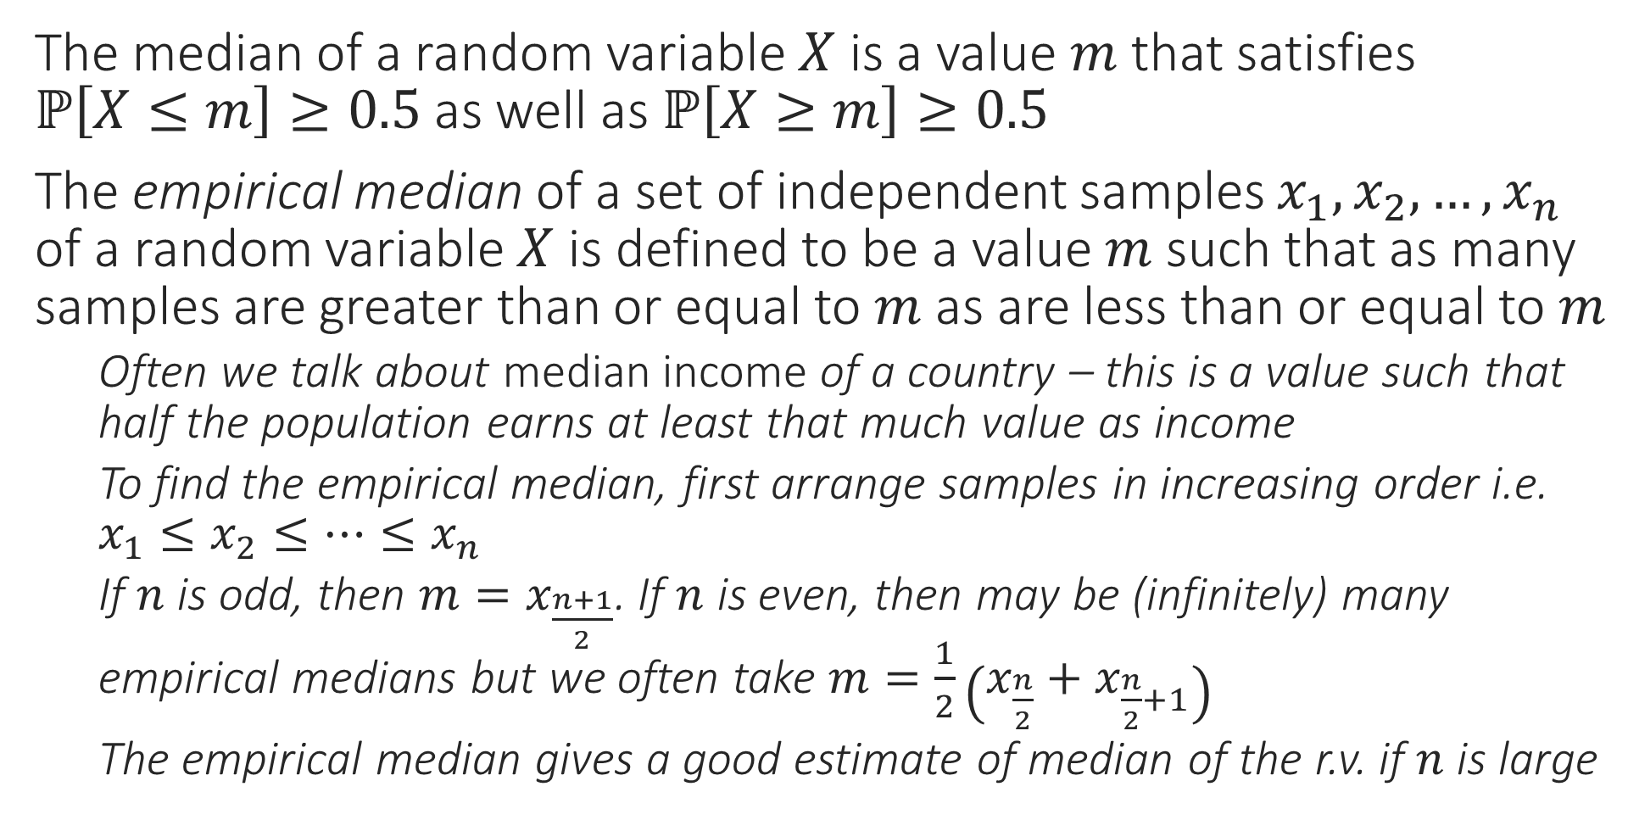


Median of a Random Variable
Interesting Fact: The empirical median is the point which is the closest to all samples in terms of absolute distance (Proof: in notes) $$\hat{𝔼}X=\arg{\min_{c}{\sum_{i=1}^{n}{\left|x_{i}−c\right|}}}$$
The median of a random variable $X$ is a value $m$ that satisfies $ℙ\left[X≤m\right]≥0.5$ as well as $ℙ\left[X≥m\right]≥0.5$
The empirical median of a set of independent samples $x_{1},x_{2},…,x_{n}$ of a random variable $X$ is defined to be a value $m$ such that as many samples are greater than or equal to $m$ as are less than or equal to $m$
Often we talk about median income of a country – this is a value such that half the population earns at least that much value as income
To find the empirical median, first arrange samples in increasing order i.e. $x_{1}≤x_{2}≤…≤x_{n}$
If $n$ is odd, then $m=x_{\frac{n+1}{2}}$. If $n$ is even, then may be (infinitely) many empirical medians but we often take $m=\frac{1}{2}\left(x_{\frac{n}{2}}+x_{\frac{n}{2}+1}\right)$
The empirical median gives a good estimate of median of the r.v. if $n$ is large
Interesting fact: even the median itself satisfies the nice property $$𝔼X=\arg{\min_{c}{𝔼\left[\left|X−c\right|\right]}}$$

